Slide 1
Challenge in the management of septic shock 2019
Supachok maspakorn

Slide 2
Interesting topics
The panel discusses the challenges in identifying
the right hemodynamic target
optimization of fluid therapy
selection of vasopressor agents
identification of patients who may benefit from inotropic agents or on the contrary beta‑blockade
use of steroids.

Slide 3
Definition
Sepsis is a life-threatening organ dysfunction caused by a dysregulated host response to infection.
Septic shock is a subset of sepsis in which profound circulatory, cellular, and metabolic abnormalities are associated with a greater risk of mortality than in sepsis alone.

Slide 4
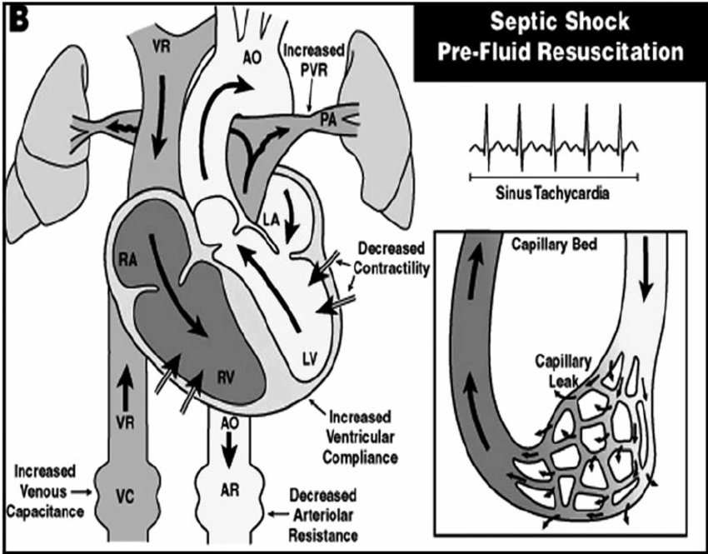
1.A profound decrease in vascular tone associated with some degree of hypovolemia. 2. Impaired cardiac output 3. Microcirculatory alterations occur, leading to alterations in tissue perfusion

Slide 5
Selecting the right hemodynamic target
Should target providing adequate organ perfusion pressure and oxygen delivery (DO2).
The organ perfusion pressure is reflected by the mean arterial pressure (MAP) for most vital organs (e.g. brain, kidney), and diastolic arterial pressure for the left ventricle.
Inadequate perfusion can be detected by simple markers such as increased capillary refill time (CRT) or mottling.
CRT> 3.5 sec indicate poor tissue perfusion.
Prolong CRT + hyperlactatemia = marked circulatory failure

Slide 6
The right hemodynamic target
Urine output is a good marker of shock at its onset, but not a good target for resuscitation. Indeed, it is neither sensitive nor specific to improvements in renal perfusion.
Lactate levels are typically > 2 mmol/L in shock states and serial blood lactate measurements are recommended.
In septic shock, normalization of lactate is recommended as a goal of resuscitation.

Slide 7
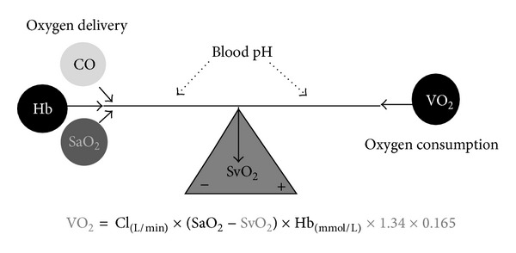
Oxygen delivery (DO₂)
The mixed venous blood oxygen saturation (SvO2)
helps in assessing the adequacy of DO2 to oxygen consumption. Low SvO2 values mean that DO2 is inadequate.

Slide 8
Optimizing fluid therapy
The decision for fluid administration is based on the recognition of inadequate perfusion, which is expected to improve after fluid administration.
Excessive fluid loading is associated with organ dysfunction and death in patients with septic shock.
A more restrictive fluid administration based on more stringent criteria was not associated with worse outcome in patients with septic shock; on the contrary, worsening of AKI appeared to be less frequent.
It is recommended that fluid administration be based on bedside evidence that CO will increase if fluids are given (fluid responsiveness)

Slide 9
Optimizing fluid therapy
The decision to discontinue fluid administration should be based on either improved peripheral hypoperfusion, absence of fluid responsiveness, or signs of poor tolerance.
The response to fluids is best predicted by dynamic indices such as pulse pressure variation, stroke volume variation, passive leg raising, or end-expiratory occlusion test.
When the decision to give fluids is made, it makes sense to use the smallest amount necessary to achieve the goal. (fluid challenge test)

Slide 10
Optimizing fluid therapy
Multicenter randomized controlled trials (RCTs) have shown harmful effects of synthetic colloids, notably AKI.
Albumin is the only colloid that has been shown to be safe in most circumstances.
Buffered crystalloids may be associated with less AKI than saline.

Slide 11
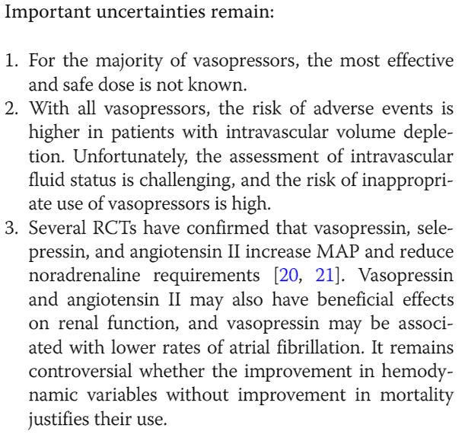
Vasopressors
The Surviving Sepsis Campaign (SSC) recommends noradrenaline as the first-choice vasopressor and vasopressin as the second-line agent.
Based on data from 32 trials published up to June 2014 (3544 patients), noradrenaline was associated with decreased all-cause mortality (relative risk 0.89; 95% confidence interval 0.81–0.98), which corresponds to an absolute risk reduction of 11%.
Compared to dopamine, noradrenaline was also associated with a lower risk of adverse events and cardiac arrhythmias.

Slide 12
Inotropes? When? Which?
Myocardial dysfunction is observed in most patients with septic shock. Decreased systolic function is a prominent feature.
Who may benefit from inotropes = who had the persistence of altered tissue perfusion + decreased ventricular systolic function + despite adequate fluid administration.
Echocardiographic assessment is desirable prior to inotropic administration in septic shock patients.
Inotropes will cause hypotension and tachycardia but will not significantly increase CO in hypovolemic patients.
Inotropes can induce or worsen atrial fibrillation and other dysrhythmias.
1st challenging

Slide 13
Inotropes? When? Which?
The SSC guidelines suggest the use of dobutamine to treat “patients who show evidence of persistent hypoperfusion despite adequate fluid loading and the use of vasopressor agents”
The targeted endpoint of an inotrope therapy may be evidence of an improvement in tissue perfusion associated with an increase in CO.
If a favorable effect is not achieved or if adverse events occur, the agent should be discontinued.

Slide 14
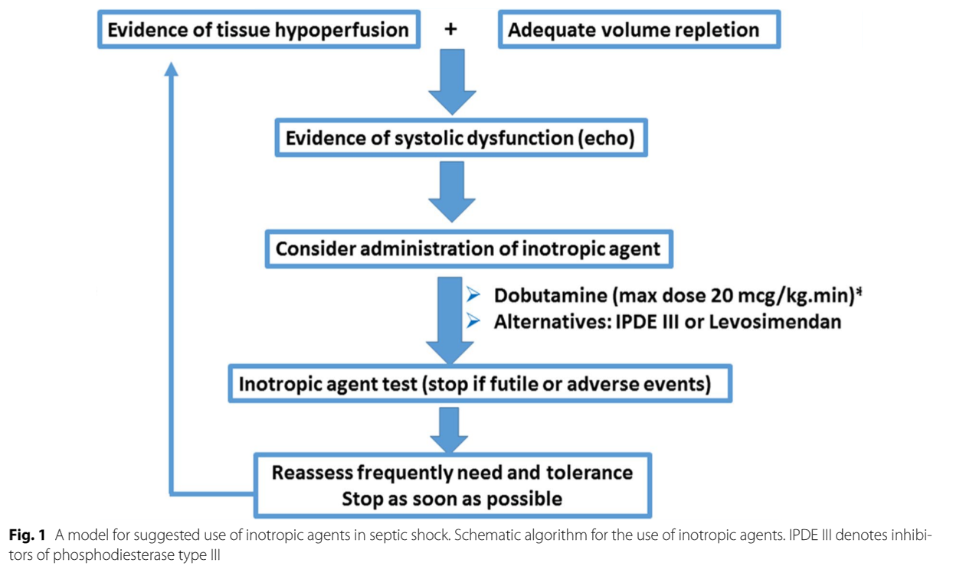
Inotropes? When? Which?

Slide 15
A place for beta-blockers?
Tachycardia is often present in patients with septic shock.
In a single-center randomized trial including 154 patients with septic shock, esmolol lowered heart rate, preserved MAP and stroke volume, and even reduced mortality.
There were many question marks. Esmolol significantly reduced DO2 by 20%. In addition, the mortality rate in the control group was extremely high (80% at 30 days, hospital mortality 91%) in patients with normal lactate levels at inclusion.

Slide 16
Microcirculation-targeted therapy?
An increase in PCO2gap may be a marker of microcirculatory dysfunction in septic shock, especially when SvO2 is normal.
Fluid administration improves the microcirculation only in early (< 24 h) sepsis.
The microcirculatory effects of vasopressors and dobutamine are variable.
Until such time, microcirculation-guided therapy in septic shock will continue to be relegated to the research arena.

Slide 17
Steroids
In 2018, two large trials on low-dose steroids were published.
The ADRENAL trial randomized 3800 mechanically ventilated ICU patients with septic shock to hydrocortisone infusion or placebo.
Mortality was similar, but the time on vasopressors, on mechanical ventilation, and in the ICU was shorter in the hydrocortisone group.
The APROCCHSS trial randomized 1241 ICU patients who had septic shock and multiple organ failure to hydrocortisone + fludrocortisone or placebo.
Mortality was lower in the steroids group, as was the time on vasopressors and organ failure.
In a systematic review of all 22 RCTs on low-dose corticosteroids in patients with septic shock, no effect on mortality was observed, but steroids reduced the time on vasopressors, on mechanical ventilation, and in the ICU.

Slide 18
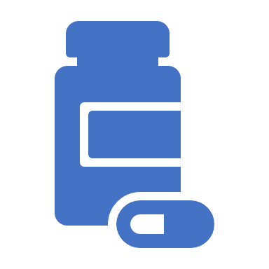
Alternative treatment
The challenge now is that extracorporeal blood purification removes cytokines from the blood in patients with septic shock, but this has not resulted in improved outcome.
A recent retrospective single-center study found a synergistic association in the use of vitamin C with hydrocortisone and thiamine, demonstrating a reduction in mortality and organ dysfunction.( the VICTAS study)

Slide 19
Impact of septic shock on antibiotics levels
Optimal dosing of antibiotics in septic shock is often not achieved with current recommended doses.
Due to an increased volume of distribution of commonly used antibiotics in sepsis, it is now well established that an initial large loading dose is required roughly 1.5 times the standard dose.
Sepsis can be associated with augmented renal clearance (ARC) or, on the other hand, with unstable, rapidly changing renal dysfunction.
In patients on renal replacement therapy (RRT), underdosing may occur.

Slide 20
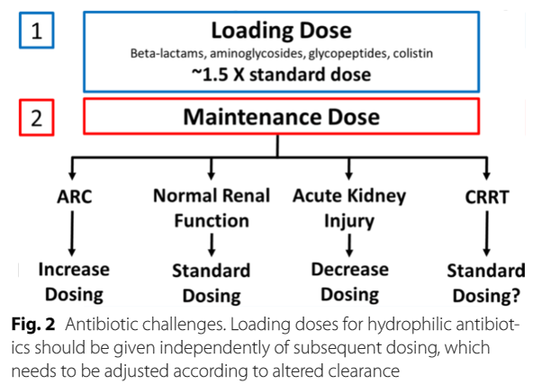
Impact of septic shock on antibiotics levels

Slide 21
Thank you for your attention

