Slide 1
PAOD for resident
Dr. Supachok Maspakorn
Chiang-Rai regional hospital

Slide 2
Intermittent claudication
Ischemic neuropathy
Intramuscular acidosis
Pain on exertion
IC involve often
single vessel
Ischemic rest pain
Reduction in distal tissue perfusion below resting metabolic requirements
Ischemic ulcer
Effect of repetitive soft tissue trauma + erosion of the overlying skin
Resting limb blood flow is insufficient to maintain cellular viability
Ischemic gangrene
CLI usually requires the presence of severe PAD at two or more levels

Slide 3
Present with IC ?
Rule out venous and neurogenic claudication
Atypical IC
Typical IC
ABI measurement
>0.9-1
>1.4
Exercise ankle pressure
DM,ESRD
≤0.9
Ankle pressure at rest
Walk 3.5km/h on treadmill incline 12%
Wait for claudication present
Rest 3 min then ankle pressure again
Diagnosis PAD
Decrease >20%

Slide 4
New diagnosis PAD
Risk factor evaluation and management
Cardiac evaluation
Associated aneurysm
Carotid evaluation
Decision making benefit & risk

Slide 5
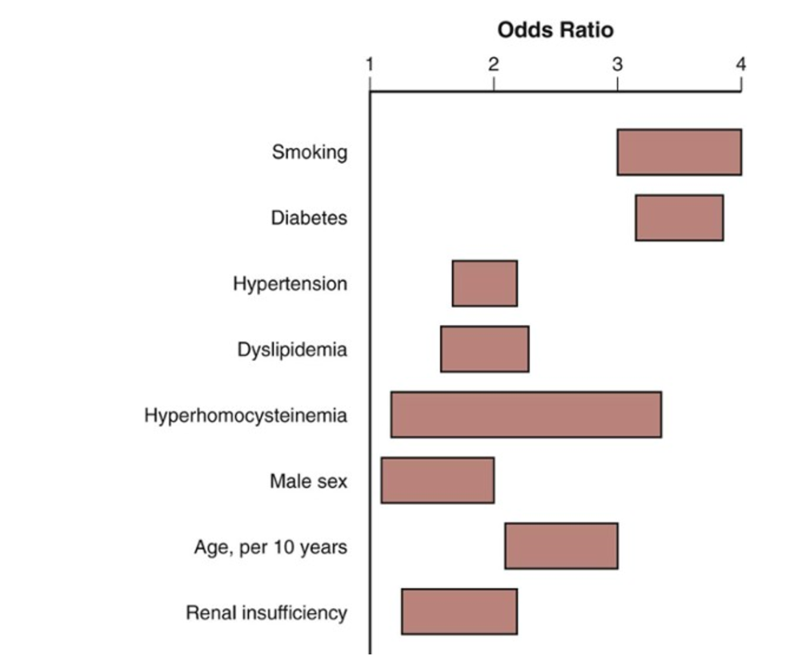
Smoking cessation
Reduce the risk of MI and death
Delay the progression from claudication to CLI and limb loss
Decrease risk of graft failure after revascularization
The current American Diabetes Association guidelines recommend hemoglobin A_{1c} levels less than 7% as a treatment goal for all patients with DM.

Slide 6
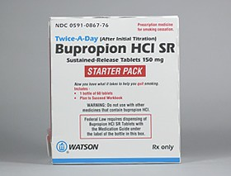
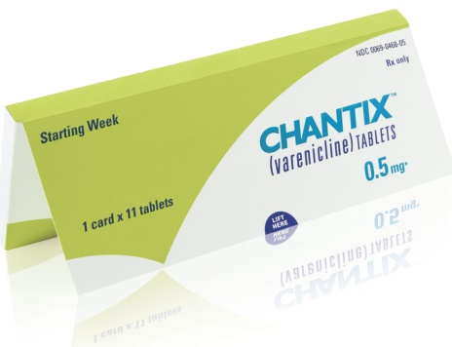
Structured smoking cessation programs have demonstrated a 22% cessation rate at 5 years, compared with 5% in patients who attempt to stop smoking independently.
Smoking cessation
Improvements in pain-free ambulation, overall walking performance and reduces cardiovascular risk but not possible in up to 34% of patients because of comorbid medical conditions, and an additional 30% of patients refuse
level IA recommendation
for the treatment of IC
Walking
30-45 min/session
3-4 times/week
At least 12 weeks
Until extreme pain tolerance
Supervised exercise program

Slide 7
Aspirin
Antiplatelet therapy
Clopidogrel (Plavix)
The only antiplatelet agent approved by the FDA for the secondary prevention of atherosclerotic vascular disease
CAPRIE trial: Plavix Vs ASA showed a relative cardiovascular risk reduction of 24% was found in the clopidogrel group
Clopidogrel was well tolerated, with few adverse effects
Reduce the risk of nonfatal MI, ischemic stroke, and vascular-related death
CHARISMA trail showed no significant difference in the composite outcome of MI, stroke, and death between dual anti-platelet versus aspirin alone

Slide 8
Hypertension
1. <140/90 mm Hg in high-risk groups
2. <130/80 mm Hg in diabetes or renal insufficiency
3. +life style modification
TASC II guidelines consider ACEI and thiazide diuretics first-line therapy for patients with PAD follow by B-blocker especially in those with concomitant coronary artery disease
ALLHAT study: 4 drugs (chlorthalidone, lisinopril, amlodipine, and doxazosin) thiazide less expensive but equivalent in benefit
Thiazide
HOPE study: ACEI reduction in subsequent stroke, MI, and vascular-related mortality with 22% risk reduction in patients randomized to ramipril
ACEI
A meta-analysis of 6 major studies concluded that beta blockade does not reduce walking distance or worsen the pain of IC
Β-blocker

Slide 9
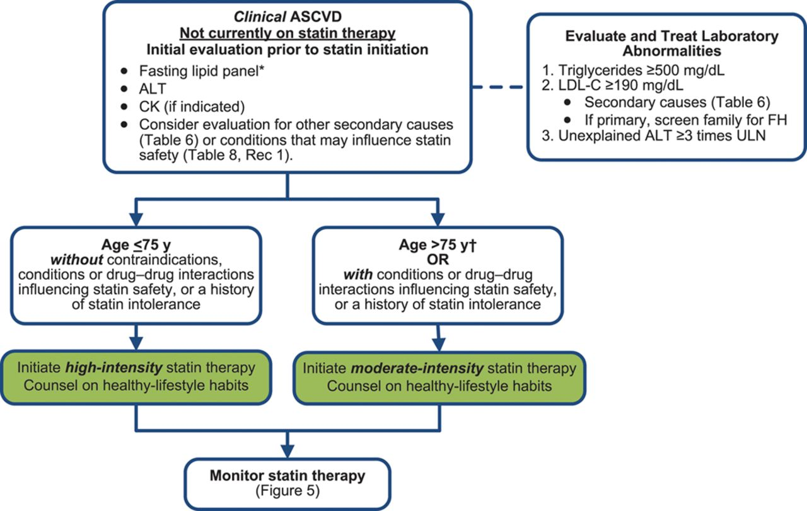
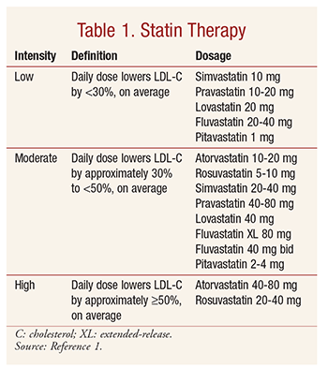
80 mg of atorvastatin for 1 year had a 63% improvement in pain-free walking
80 mg atorvastatin had more LDL lower and more lower major cardiovascular event compare with 10 mg atorvastatin

Slide 10
Cardiac evaluation for non-cardiac surgery

Slide 11
CLI is associated with a high risk of limb loss in the absence of revascularization, whereas claudication rarely progresses to the point of requiring amputation.

Slide 12
Claudication: Traditional treatment recommendation
Goal = preserving life and limb
Balanced the risk of intervention against the natural history of the disease
Initiate systemic medical therapy
low relative risk of limb loss (1%/year) compared with the significant relative risk of stroke, MI, and death (3-5% /year)
Revascularization
Severe claudication and after failed medical therapy

Slide 13
Critical limb ischemia (CLI)
Primary role = revascularization
Secondary role = medication + risk modification
The relief of CLI
Do nothings
= 40% limb amputation in 6 months
Patients too sick or infirm to realize the benefit of limb revascularization should undergo palliative primary above-knee amputation.

Slide 14
Claudication that limit quality of life
Medical therapy
Suspected proximal lesions
Improve symptoms
Continue medical treatment
Localize lesion: CTA, MRA or convention angiography
Revascularization:
Endovascular or surgery
Symptoms not improve or deteriorate

Slide 15
CLI confirm
Not candidate for revascularization
candidate for revascularization
Stable pain and lesion
Medical treatment
Localize lesion: CTA, MRA or convention angiography
Revascularization:
Endovascular or surgery
Pain intolerant or spreading infection
Amputation

Slide 16
Thank you for your attention

